Slide 1
WORD FINDER FOR IOS A ctrl+f for your textbooks

Slide 2
TEAM: AYUSH SHRIVASTAVA ARMANDO QUINTANA

Slide 3
PROBLEM
A lot of students struggle with finding topics or words they are looking for in a textbook or a document
especially during exam times when students need to adapt to quick learning tactics, a lot of their time is wasted just to look for the content they are looking in the textbook.

Slide 4
Market/audience
The target audience for this app are students and office employees
It is basically for anyone who even has a minor connection to reading

Slide 5
Product/app idea
It takes user’s word input and then uses the cell phone camera to find the inputted word in a text document and highlight it.
It includes features like saving the word for future use.
It also allows a user to input the page no./para no. they found the word at so they don’t have to search for the same word later

Slide 6

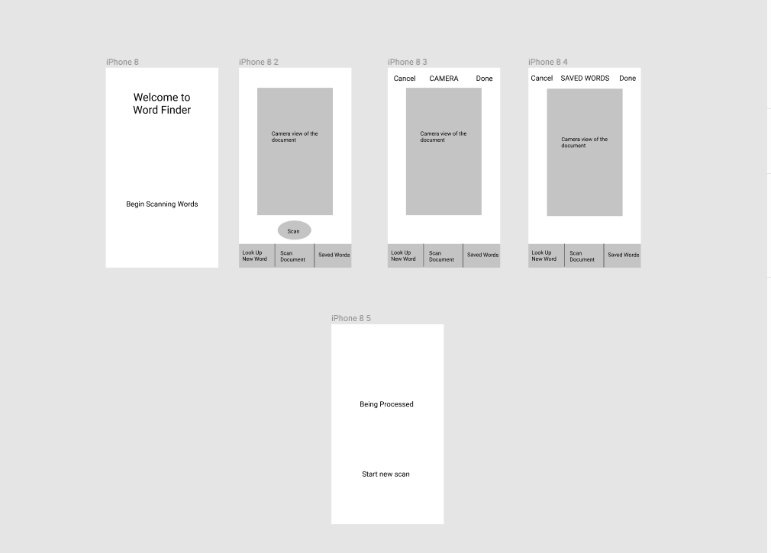
wireframes

Slide 7
roadmap
In the future, we would try to get more features and get better bug fixing
We will also be trying to make the AI smarter so it can detect hand written notes as well.

